Slide 1

Vision AI in 5 Days
Image Recognition Project
Dataset: CIFAR-10 (Object Recognition)
Project Goal: Build and fine-tune an image classifier to demonstrate end-to-end predictions efficiently.

Slide 2

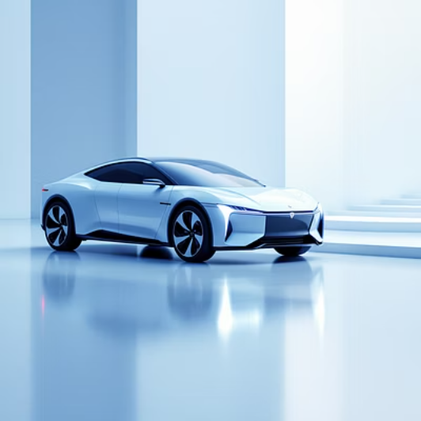

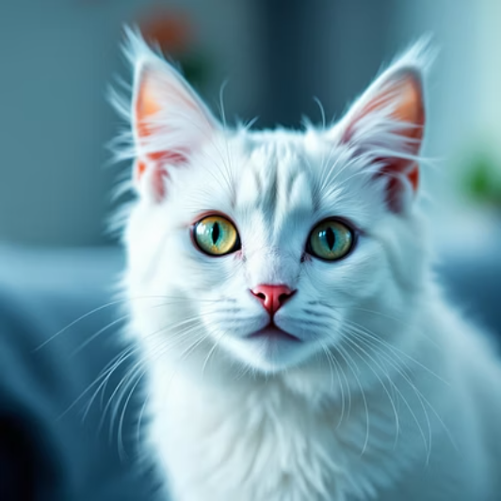

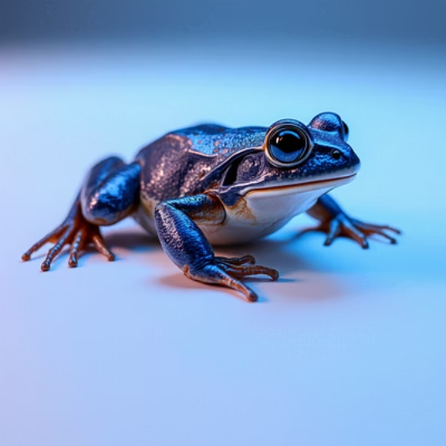
Dataset & Preprocessing
Dataset Size & Classes: 60,000 images (50,000 training, 10,000 testing) across 10 distinct classes (e.g., airplane, car, bird, cat, deer, dog, frog, horse, ship, truck).
Sample Images from CIFAR-10 Dataset
Image Size Used: Resized to 224x224 pixels to match standard input for transfer learning models, while retaining sufficient detail for classification.
Key Preprocessing & Augmentation: Images were normalized (pixel values scaled to [0,1]), and augmented with random rotations (up to 15 degrees), horizontal flips, and minor shifts to enhance model robustness and prevent overfitting.

Slide 3
Models & Training
Model Architectures Explored:
Training Details:
Baseline CNN: A custom convolutional neural network featuring sequential Conv2D layers, Max-Pooling, Global Average Pooling (GAP) for dimensionality reduction, and a final Dense layer for classification. Simple and effective for initial benchmarks.
Epochs: 25-50 epochs, with early stopping implemented to prevent overfitting and optimize training time.
Batch Size: 32, a common choice balancing memory usage and training stability.
Transfer Learning (MobileNetV2): Utilized pre-trained MobileNetV2 on ImageNet. The base layers were initially frozen, followed by fine-tuning the top layers to adapt to the CIFAR-10 dataset, leveraging learned features from a vast dataset.
GPU: NVIDIA Tesla P100 (Google Colab Pro), accelerating computations significantly.
Optimizer: Adam, with an initial learning rate of 0.001, adjusted dynamically with a learning rate scheduler.
Comparison of Baseline CNN vs. MobileNetV2 Accuracy
Baseline CNN
68.5%
MobileNetV2 (Transfer Learning)
91.2%

Slide 4
Results & Evaluation
Best Validation Accuracy: The fine-tuned MobileNetV2 achieved a top validation accuracy of 91.2% on the CIFAR-10 test set, significantly outperforming the baseline model.
Confusion Matrix for MobileNetV2 (Normalized)
The matrix illustrates strong classification, with minimal confusion primarily occurring between similar animal classes.
Precision/Recall/F1 Summary: Achieved high scores across most classes. Notable performance in "airplane" and "ship" (F1 > 0.93), with slight dips in "cat" and "dog" due to higher intra-class variance.
Main Failure Mode: Misclassification between visually similar classes, particularly "cat" and "dog," and sometimes confusing "deer" with "horse" due to similar anatomical features and posing. This highlights the challenge of distinguishing fine-grained details.

Slide 5




Conclusion & Next Steps
Project Summary
Limitations
Next Improvements
Successfully built and fine-tuned a highly accurate image classifier for CIFAR-10 within 5 days, showcasing rapid AI development capabilities.
Primary limitations include data size (larger datasets could improve generalization) and class imbalance for some real-world applications (though not prominent in CIFAR-10).
Future steps include experimenting with more advanced augmentation, ensemble methods, exploring other transfer learning models, and deploying the model as a practical, accessible API.
Repo & Demo: https://github.com/24f2004698/Image_recognition_AI.git

